Slide 1
Farm-Easy

Slide 2
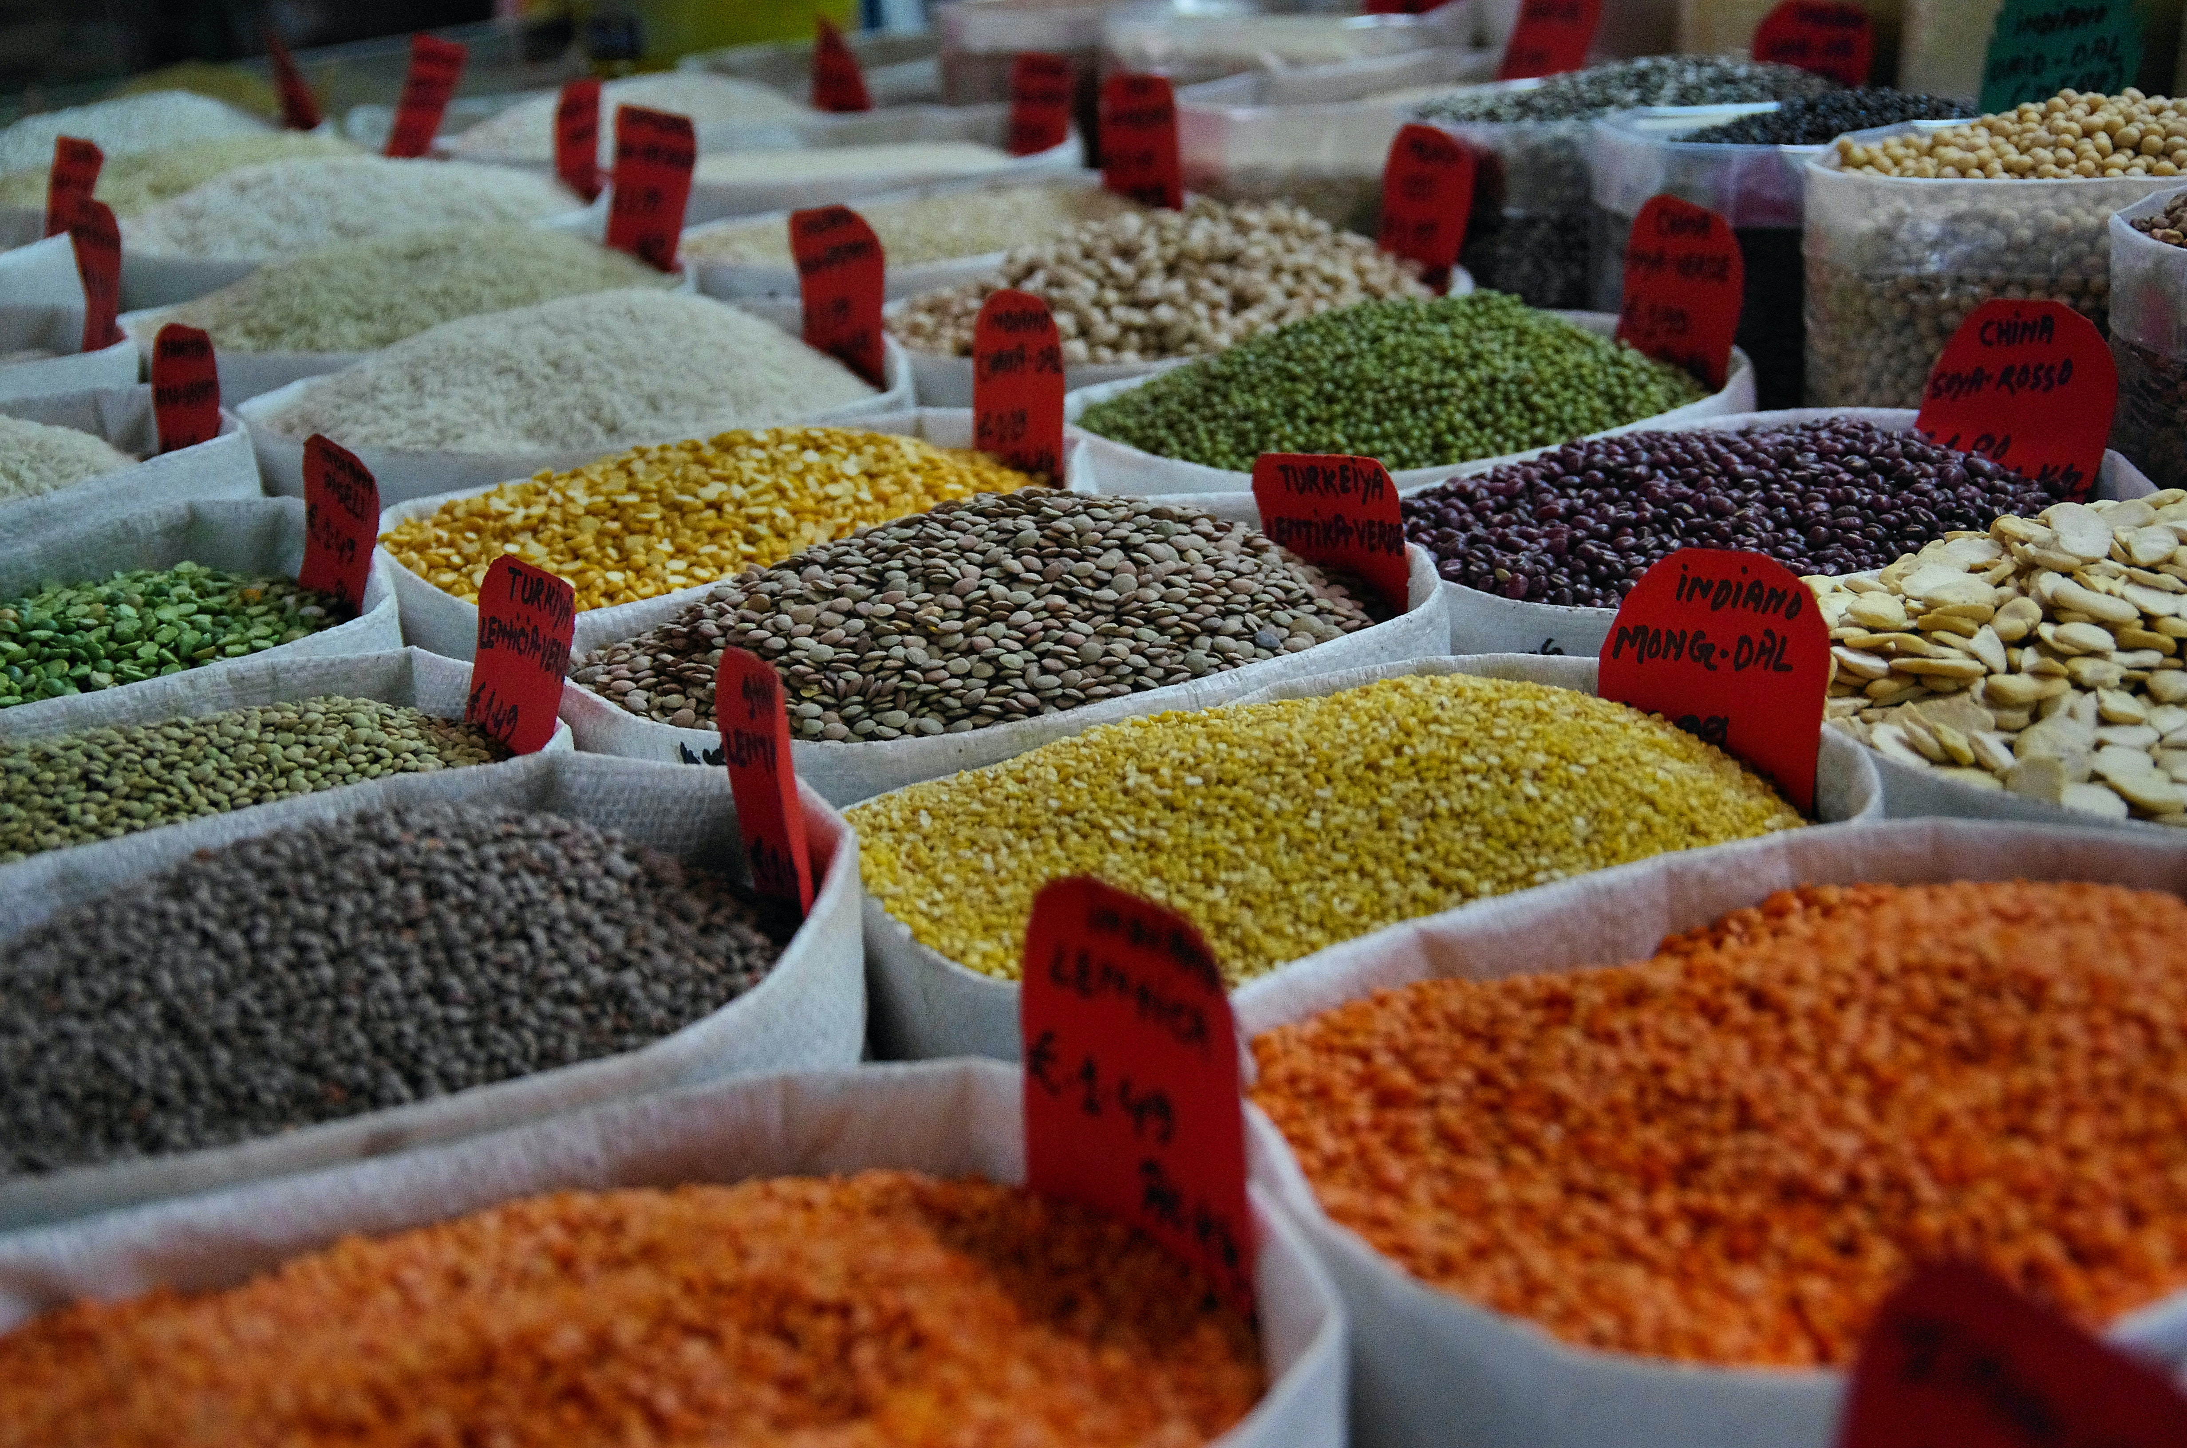
Problem:
India ranks amongst the world's five largest producers of over 80% of agricultural produce items.
However, farmers in our country are often duped by private money lenders and various financial entities by charging excess rate of interest on their loans.
Prevailing farm management system helps the farmers only on the agricultural front and provides minimal assistance on the monetary front.
Farmers loose their entire arable land even in the case of partial repayment of their debts/loans. There is no framework to monitor the equivalence between the amount of pending debt and the collateralized land.
Current Scenario

Slide 3

Solution: Farm-Easy
Aid to farmers
About:
Farm-Easy is web-based platform to assist farmers in selecting crops to be be harvested in the upcoming crop cycle.
It will also assist in procuring loans to the farmers using Blockchain based P2P (peer to peer) platform.
Inspired by the DeFi (Decentralized Finance) ecosystem, our platform is based on the P2P digital INR pool providing a better rate of interests to lenders [financial entities and individual investors] and the beneficiaries [farmers]
Farmers can avail loan from the digital INR pool by collateralizing their land in terms of NFTs (Non-Fungible Tokens) issued by Govt. based on details of farming plot at the local Tehsildar office.
Assigning NFTs to smaller pieces of land helps in preventing the entire confiscation of land in-case of partial repayment of their debts.

Slide 4



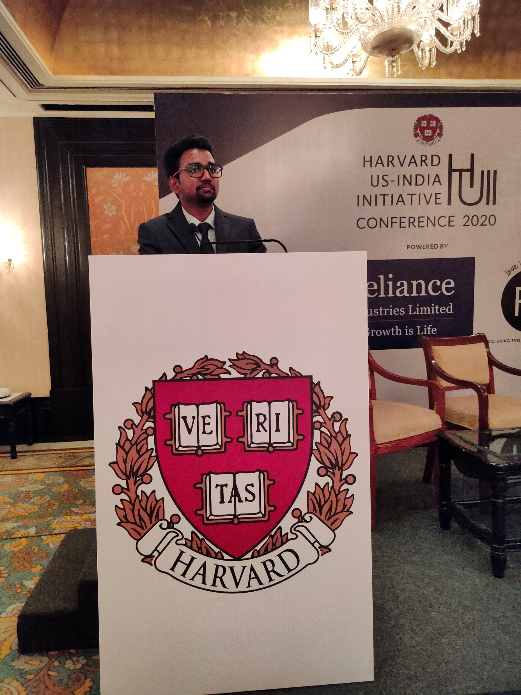

Our Team
Rishabh Ashok Sanghai
Team-Lead
Jasim Mallick Video Editing & Presentation
Devang Pokhar
Front-End Developer
Shankar Warang Backend Developer
Swarangi Satpute Design & Integration

